Slide 1
No Men Are Foreign

Slide 6
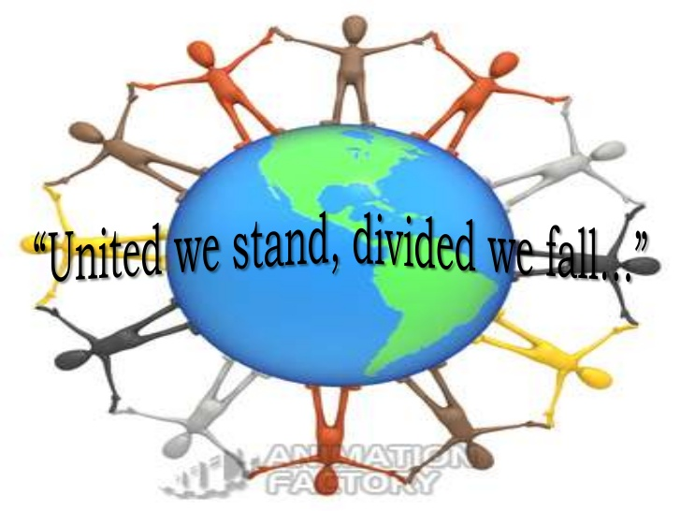

Slide 9
Stanza 1
Remember, no men are strange, no countries foreign
Beneath all uniforms, a single body breathes
Like ours: the land our brothers walk upon
Is earth like this, in which we all shall lie.

Slide 10
Explanation
In the first line the poet says that no men are strange, and no country is foreign. So, he is attempting to remove the borders from the Earth which have been erected to separate different countries. Then only no country will be foreign. We will feel every country as our own land when there will be no borders, everyone will be free to move around. The poet wants to say that the entire Earth is one and all the people who live on this Earth belong to one human race. Then he says that inside the uniforms worn by soldiers of different countries, the human being is the same. God has made all of us in a similar way. All breathe in the same way. Then he says that all the soldiers are our brothers – we all walk upon the same ‘Mother Earth’ and upon our death, shall lie in the grave in the same Earth.

Slide 11
Stanza-2
They, too, aware of sun and air and water, Are fed by peaceful harvests, by war’s long winter starv’d. Their hands are ours, and in their lines we read A labour not different from our own.

Slide 12
Explanation
‘They’ refers to those people who belong to other countries. We call them foreigners and discriminate them and fight with them also. The poet says that nature has given all the bounties to all people also just like he has given to us. Everyone gets sunlight, air and water in equal measure which means that God does not differentiate between people from different countries. We all do farming during the time of peace, when there is no war. We live a relaxed life and eat the things given to us by nature. Further, he adds that the way we starve during wars and winter time is the same for those belonging to other countries. Even they don’t get food at that time. So, he wants to say that foreigners who belong to another country and we, both are same. And then the poet says that even their hands are same as ours, they work very hard just like we do.

Slide 13
Stanza-3
Remember they have eyes like ours that wake Or sleep, and strength that can be won By love. In every land is common life That all can recognise and understand.

Slide 14
Explanation
The poet asks the reader to remember something. He says that we should keep in mind that the people of another country, whom we think to be our enemies, have been bestowed by God with similar appearance like us. God has given them eyes like ours which open when awake and close when we are asleep. Similarly, he has given them strength which we can win through love. Then he says that in every country, in every land there is one common thing, that is life. Life means all the things that are living. And if we can recognize them and if we can understand their feelings and realize that they are like us, then there will be no fights or wars between us.

Slide 15
Stanza-4
Let us remember, whenever we are told To hate our brothers, it is ourselves That we shall dispossess, betray, condemn. Remember, we who take arms against each other

Slide 16
Explanation
The poet says that we should remember that whenever someone tells us to hate a person from another country, to think him as our enemy, and whenever we think someone to be our enemy, then we deprive ourselves, we cheat ourselves, and we condemn ourselves. He says that we should stay away from such negativity. We should not consider anyone to be our enemy. During a war, both the parties must bear the loss. And that is why the poet says that war is not in our favour.

Slide 17
Stanza-5
It is the human earth that we defile. Our hells of fire and dust outrage the innocence Of air that is everywhere our own, Remember, no men are foreign, and no countries strange. defile: make dirty; pollute outrage the innocence of: violate the purity of

Slide 18
Explanation
We should keep in mind that whenever we pick weapons against any person, we make the Earth dirty because weapons kill people and their bodies which fall on the Earth make it dirty. Whenever war happens, it leads to a lot of bloodshed, fire and death. These dead bodies accumulate on the Earth and it make it impure. The fire of war which erupts, the smoke which comes out, the dust which fills the air - it is so dirty that it pollutes and outrages the purity of the air. With all these things the poet wants to give us a message that we should not indulge in war. Finally, he ends the poem by writing the first line in reverse and saying that Remember, no men are foreign, and no countries strange.

Slide 22
Literary Devices
Rhyme Scheme - The entire poem is written in free verse. There is no rhyme scheme in the poem.
The literary devices used are as follows –
Alliteration: The repetition of a consonant sound in two or more closely placed words is called alliteration. The instances of alliteration in the poem are -
Stanza 1 - Body, breathes ‘b’ sound is repeated
Stanza 2 – war’s, winter ‘w’ sound is repeated

Slide 23
Literary Devices
Metaphor
Stanza 1 - Uniform refers to the military of different countries
Stanza 2 – wars time is compared to the winter season
Repetition: It is used in the entire poem.
‘Remember’ word is repeated 5 times in this poem.
‘Remember, no men are strange, no countries foreign’ is repeated in stanza 1 and stanza 5
Enjambment - running lines of poetry from one line to the next without using any kind of punctuation to indicate a stop. Instances of enjambment in the poem are as follows-
Stanza 1 – line 2, 3 and 4
Stanza 2 – line 3 and 3
Stanza 3 – line 1, 2, and 3
Stanza 4 – line 1 and 2
Stanza 5 – Line 2 and 3

Slide 24
